Slide 1
Superstore helpline
A Winter 2018 Capstone Project By: Abhay Singla
Guru Sharma
Saqib Jaweed Syed

Slide 2
The Hardware
A Raspberry Pi 3-B $40.00
A PIR Sensor (HC-SR501) $5.00
A Touchscreen $40.00
An LED $0.25
WHY? ? ?
Only 2 hours to build
Low-priced
Can be Modified

Slide 3
The Gui
The gui is the hardware heart of the project, it is the thing that helps the kiosk screen and the android app decoupled from each other.

Slide 4
The programming language
Python was chosen as the language to make the GUI because all the hardware code was in the same language
Python libraries are easier to find and works well with the broad com development platform that we used (The Raspberry Pi)

Slide 5
The Gui library
Tkinter library for python2.7 was used to create the GUI
It was used because it was the most basic GUI library in python that supported application like features, like supporting toggle between multiple pages.

Slide 6
The firebase library
Pyrebase library was used as the firebase library.
It is a envelope library around the python-firebase library that includes features like multi-user authentication and also the function names are a bit more intuitive in this library.

Slide 7
Highlights of our App
Simplicity and User friendly interface
Real time data changes reflected
Easy to use

Slide 8

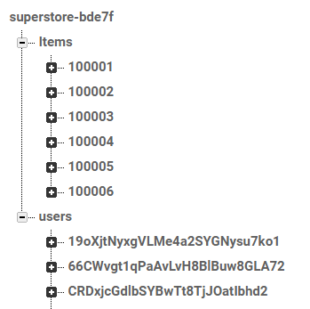
Connection with database
Uses Google’s Firebase real time database
Safe and secure
Database of items created
User information saved under users node
Only authenticated users can use it

Slide 9
How it works
Allows users to Sign Up and Sign In
Shows user cart when login successful
Users can see and modify their cart
Shows item count and total price
Allows to delete and add items from cart
Shows detailed description of items along with their SKU, aisle number, price details and the brand name

Slide 10
Previous Course Knowledge
Intro to Software Engineering:
Learned to create Gantt Charts for better scheduling and prioritizing tasks
Technical C:
We were taught how to get started with Raspberry Pi and how to use and configure GPIO pins.
Android Programming:
We learned how to make the app and how to manage the database.
This Course:
This was the only course which gave us an insight on how to play-around with Raspberry Pi and modify system settings to incorporate out sensors code into the Raspbian OS. Another very important skill we learned in this course was using Github effectively.

Slide 11
Thank You
Questions?

